Slide 1
Increasing Visibility, Accessibility, and Citations Through Open Access Publishing
Presentation to The Alan Shawn Feinstein Graduate School Faculty
December 7, 2011

Slide 2
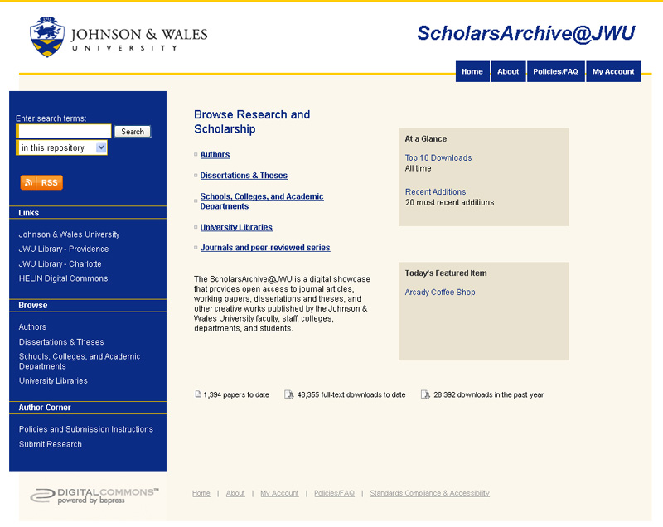

Slide 3
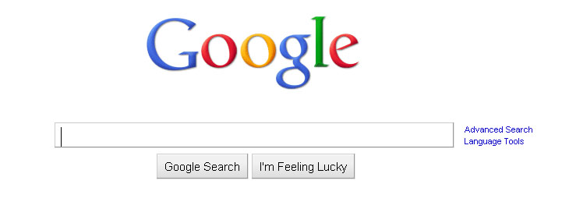
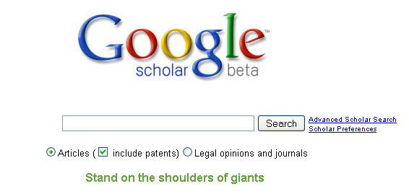
The Power of Open Access Scholarship

Slide 4
Author Benefits
Monthly download reports (automatically generated and emailed to you directly from Bepress)
Greater organization and optimization for web searches
Permanent links and citations for easier dissemination
Visibility & Findability: What once was “lost”, can now be found!

Slide 5
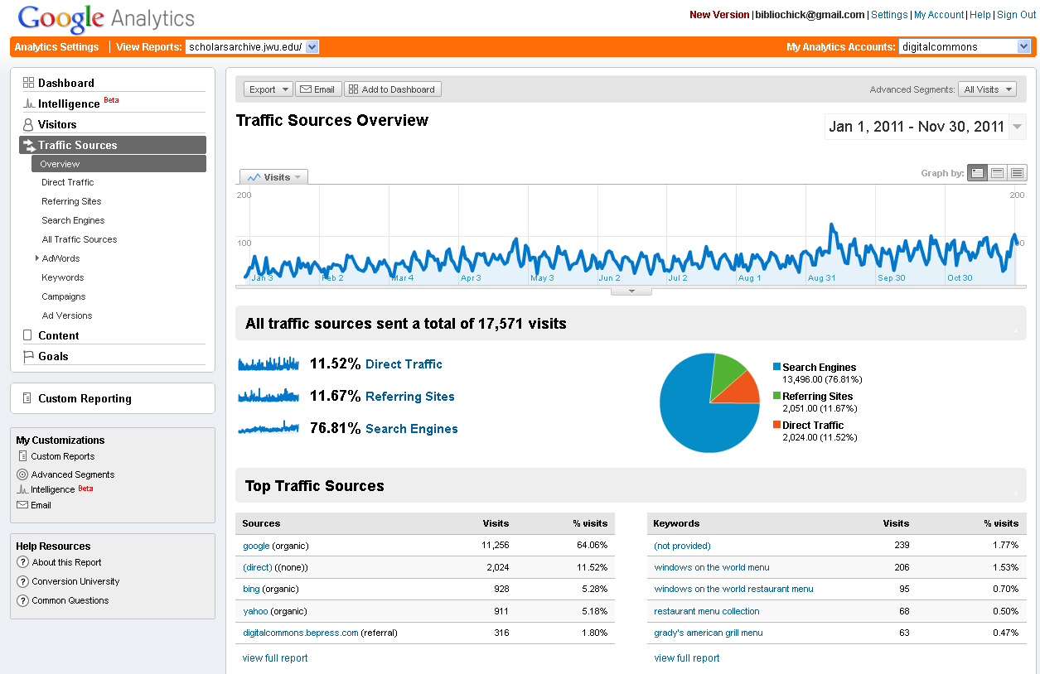

Slide 6
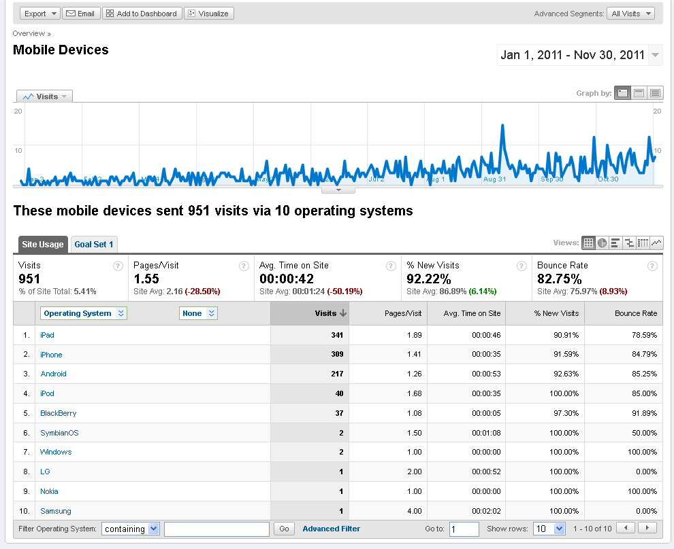

Slide 7
Publisher & Author Copyrights
Authors retain copyright for work added to the IR
Authors can activate additional Creative Commons licensing to any of their work in the IR http://scholarsarchive.jwu.edu/staff_pub/11/ http://creativecommons.org/licenses/
Publishers copyright permissions are more flexible than ever http://www.sherpa.ac.uk/romeo/issn/0898-0306/
Item records can be customized to include additional comments or links to related material as well as citations to original published version http://scholarsarchive.jwu.edu/mba_fac/1/
Abstracts and citations can be added if IR publishing permission cannot be obtained http://scholarsarchive.jwu.edu/technology/3/ http://scholarsarchive.jwu.edu/cyberbullying/6/

Slide 8
How to Contribute Your Work
Submit works to Scholars Archive administrator (me) to submit work on your behalf
Create your own account and self-publish*
Designate someone to collect and add work for a specific series*
*I will provide training and support.

Slide 9
Thank you!
Please contact me anytime for further information. egearing@jwu.edu

Slide 10
Multimedia, Peer Review, & Journals
Streaming Audio:
Salve Regina University- Public Lectures Series http://escholar.salve.edu/pub_lect/3/
Streaming Video:
Utah State University- Instructional Technology and Learning Sciences Videos http://digitalcommons.usu.edu/itls_videos/
Journals & Magazines, Conferences, Peer Reviewed Series UNLV http://digitalcommons.library.unlv.edu/peer_review_list.html

